Slide 1
Tips, Teaching Point, and The Teach
The Minilesson
Presented by
Mike Thomas ☺
Kindergarten Teacher

Slide 2
Why a Minilesson
Aligns with a Workshop Approach
Targeted Learning
Focused and Direct Instruction
Guided Practice
Independent Practice

Slide 3
Minilesson
Learning Target
Teaching Point
Teach (5-10 minutes)
  Connect
  Active Engagement
  Link
Mid Workshop Teach (1-2 minutes)
Conferencing
Keep Tips (Read Tips)

Slide 4
Sample of Minilesson Components
https://www.youtube.com/watch?v=QgCXRD53Iog

Slide 5
Creation
Learning Target
  What will your student be able to do
Teaching Point
  What is your instructional focus
Teach
  The Meat
  Connect - activate prior knowledge
  Active Engagement – turn and talk, show me, 1-4
  Link – connecting to their current work
Mid Workshop Teach
  Reteach, show example, quick management lesson
Conferencing – notes can relate to new teaching points
Keep Tips (read tips from previous teaching, share with others)

Slide 6
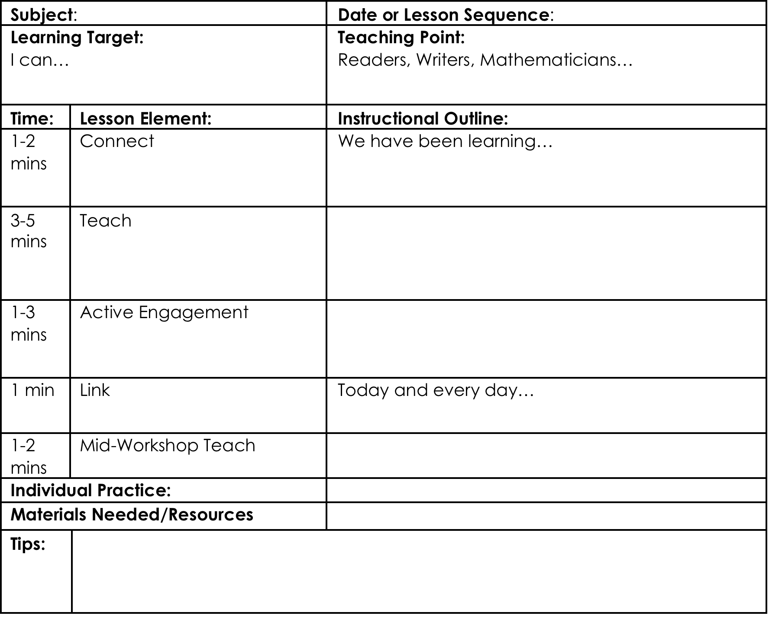

Slide 7
Tracking Student Progress
Class Profile
Conference Notes

Slide 8
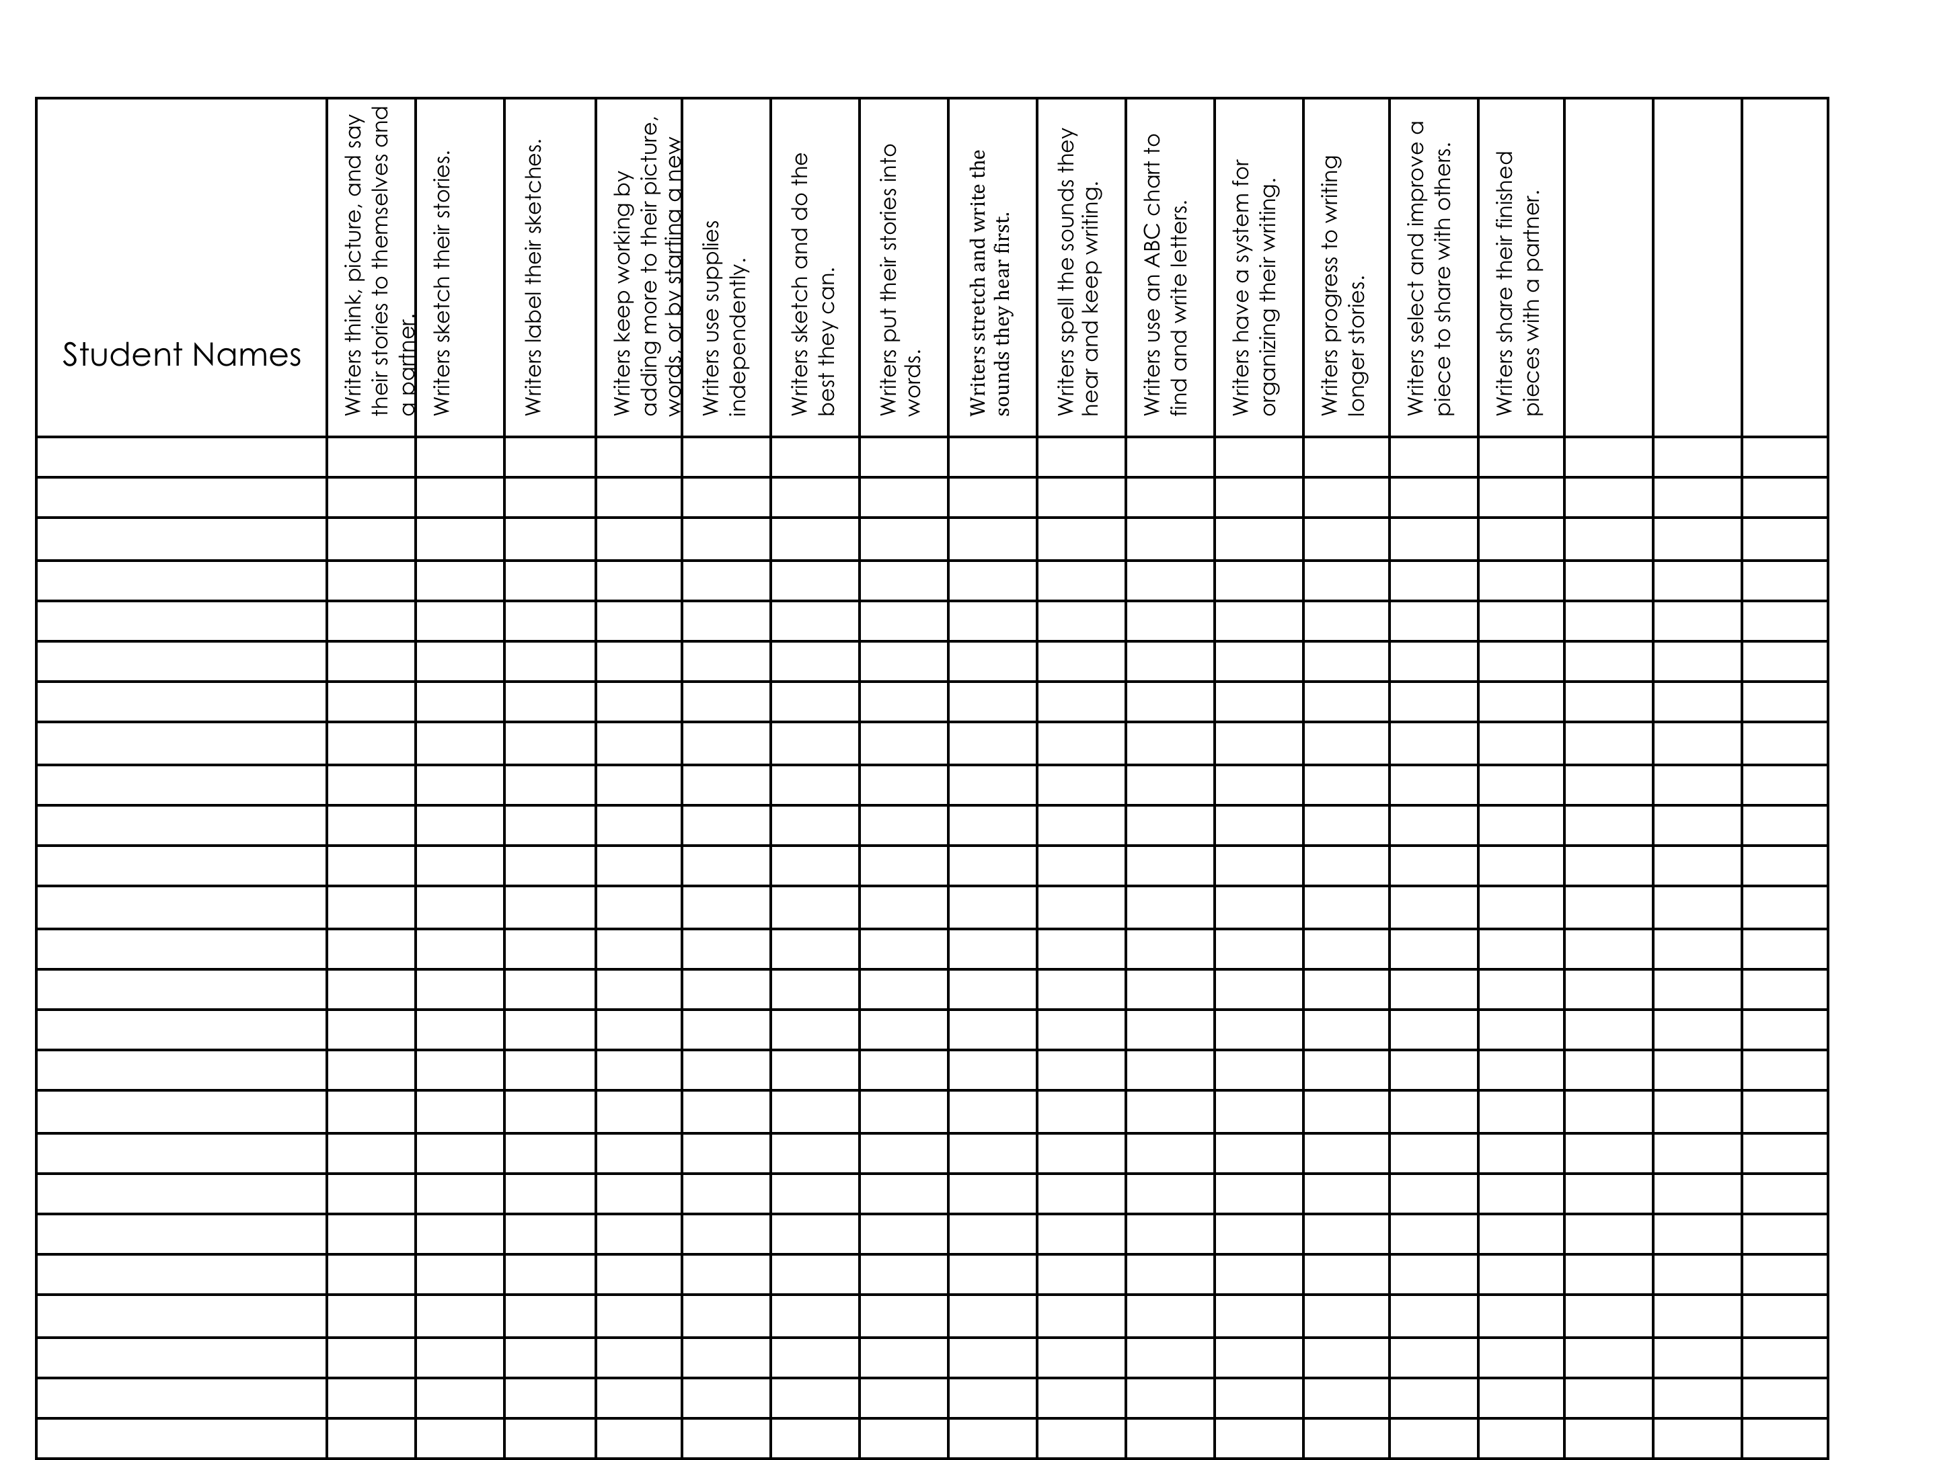

Slide 9
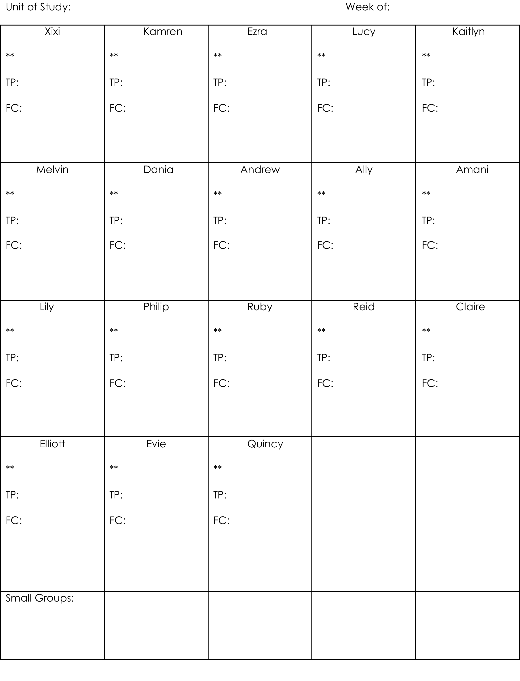

Slide 10
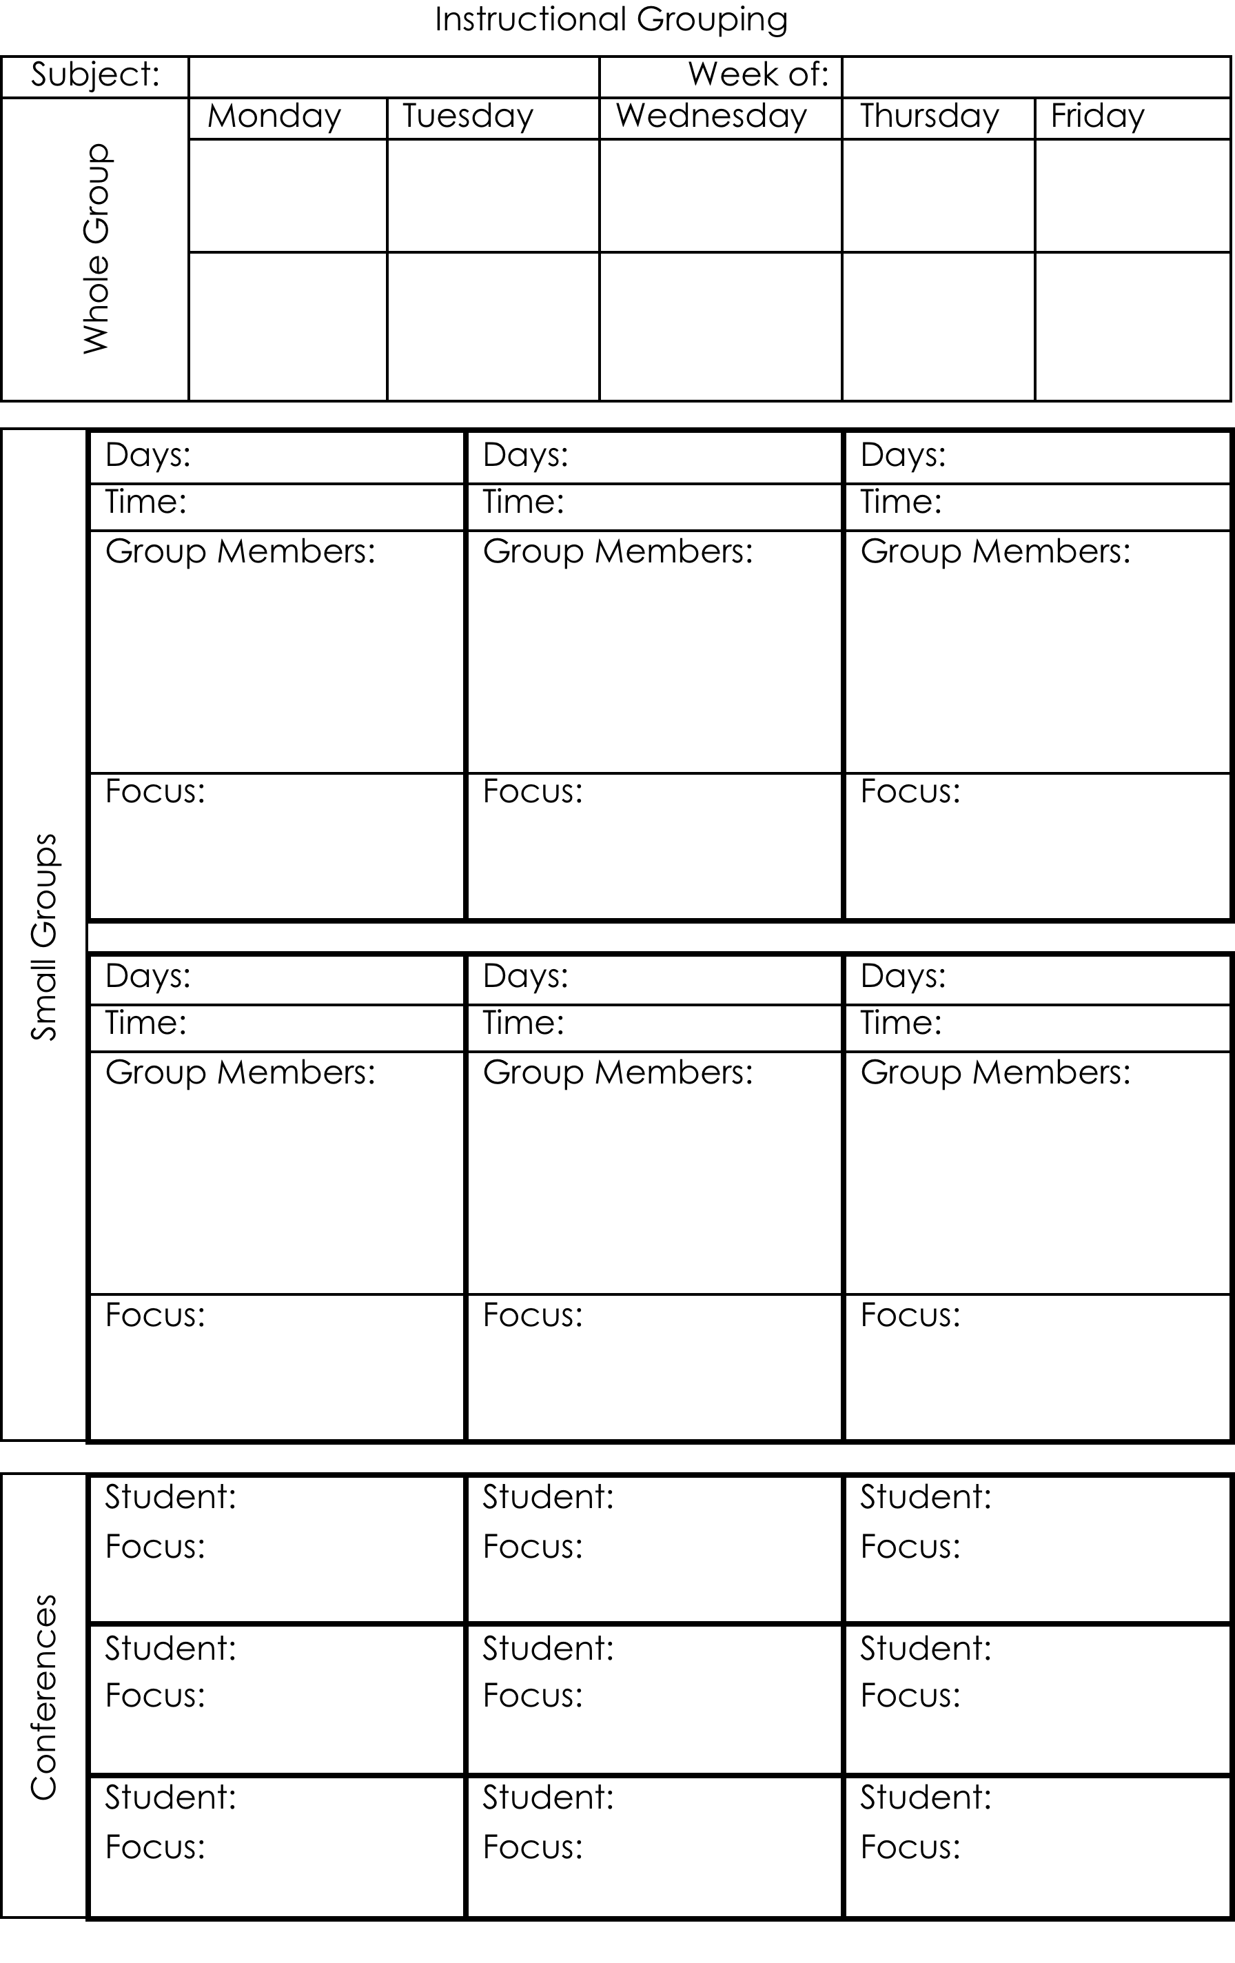

Slide 11
Conference and Small Group Instruction
60% rule
Teaching points are great focuses for conferences and small group instruction
Guided Instruction
Instructional Evidence

Slide 12
Share with Colleagues
Share
Divide and conquer
PLC Conversations

Slide 13
Questions???

