Slide 1
Classroom Disruptions:
Preventing and Responding

Slide 2
Essential Question
4. How can I effectively prevent and respond to disruptions?

Slide 3
http://www.ted.com/talks/rita_pierson_every_kid_needs_a_champion

Slide 4
Purpose of this session
Explore individual preferences for sound and movement
Understand the benefits of creating voice and movement scales
Determine individual needs for all class activities
Create a plan for teaching students

Slide 5
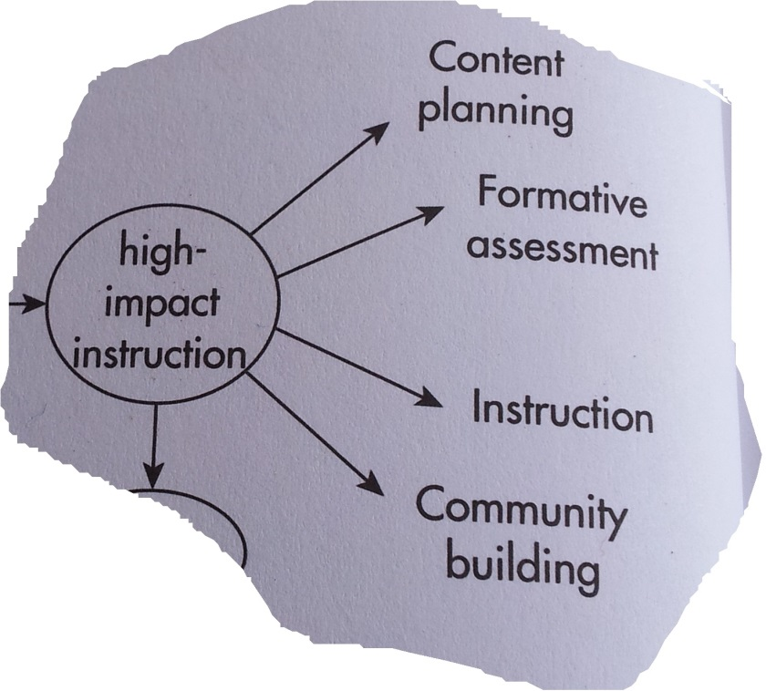
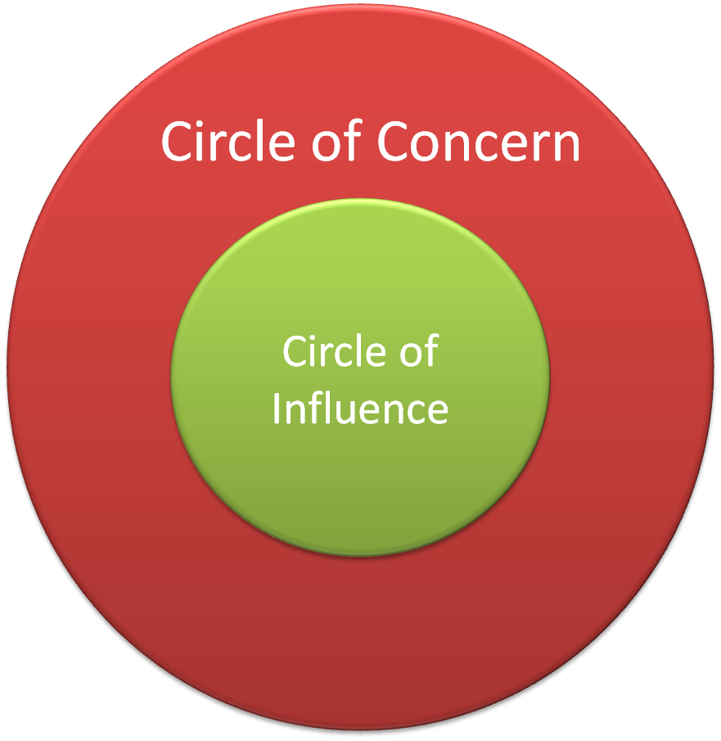
The greater context

Slide 6
Staff will identify current state in the context of their classrooms
What types of disruptions do you experience most frequently? Choose 1-2
Use sticky notes to collect ideas
Document on your planning form

Slide 7
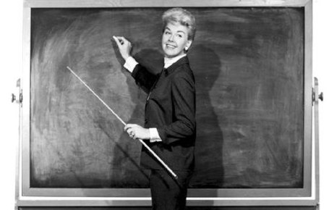
Preventing Disruptions: After You Have Taught Your Expectations

Slide 8
Early Stage Interventions
Precorrection
Proximity
Gentle Verbal Reminder (not harsh)
Discussion
Family Contact
Humor
Acknowledge kids who are doing the right thing
Resititution
No Emotion!

Slide 9
Early Stage Corrections (disc 2, Ch 3, Task 3)

Slide 10
Mild Corrective Consequences
Time Owed
TimeOut (In-Class)
Timeout (In Another Class)
Restitution
Positive Practice
Response Cost- Loss of Points
Response Cost Lottery
Detention
Behavior Improvement Form
Demerits

Slide 11
Mild Corrective Consequences Disc 2, Ch. 3, Task 4

Slide 12
Take a Moment to Reflect
“Corrective” Consequences while kids are still learning expectations

Slide 13
Also
The Conditions
The Behavior
The Consequence

Slide 14
Managing Power Struggles
You must be able to be firm but free from anger; don’t personalize attacks. Stay neutral!
Possible Strategies:
Separate student from audience; this can remove fuel from the fire
Table the matter until later
State both viewpoints: “You think this…I think that…”
Deliver a Closing Statement: “We’ll talk about this later. I need to finish this first”

Slide 15
Power Struggle Strategies, continued…
Take a Personal Time Out (PTO): “I need to think about this because I don’t feel comfortable talking about it now…”
Fogging Statements: Veer off onto a related but tangent topic or just say “I agree with you”
Effective Statements that avoid escalation:
“That’s an interesting opinion”
“There’s probably a lot of truth in what you say. Sometimes you may feel angry when you think I’ve been unfair”
“You might be right”

Slide 16
Take a Moment to Reflect
Early Stage Corrections: What problem(s) Do you want to solve?

Slide 17
Resources
Mary.Perfitt.Nelson@oakland.k12.mi.us
Dr. Pierson’s video: http://www.ted.com/talks/rita_pierson_every_kid_needs_a_champion
Safe and Civil Schools (Randy Sprick) http://www.safeandcivilschools.com/
Randy Sprick’s Interventions: https://www.dropbox.com/s/57vpr1140i8lt19/Sprick%204-26-12.pdf?dl=0
Engaged Teaching and Learning: http://www.scoop.it/t/engagement-based-teaching-and-learning

